Slide 1

Geometry
Unit 9, Lesson 9 Surface Area in the Real World Volume 2, pg. 100

Slide 2


Benchmark
MA.912.GR.4.6
Solve mathematical and real-world problems involving the surface area of three-dimensional figures limited to cylinders, pyramids, prisms, cones, and spheres.
volume 2, pg. 100

Slide 3
Integrated Mathematical Thinking and Reasoning Standards
MA.K12.MTR.1.1 Actively participate in effortful learning both individually and collectively.
MA.K12.MTR.3.1 Complete tasks with mathematical fluency.
MA.K12.MTR.4.1 Engage in discussions that reflect on the mathematical thinking of self and others.
MA.K12.MTR.6.1 Assess the reasonableness of solutions.
MA.K12.MTR.7.1 Apply mathematics to real-world contexts.
volume 2, pg. 100

Slide 4

Learning Targets
I can solve real-world problems involving the surface area of cylinders, pyramids, prisms, cones, and spheres.
I can solve real-world problems involving the surface area of composite figures.
volume 2, pg. 100

Slide 5

Warm-Up
volume 2, pg. 100

Slide 6
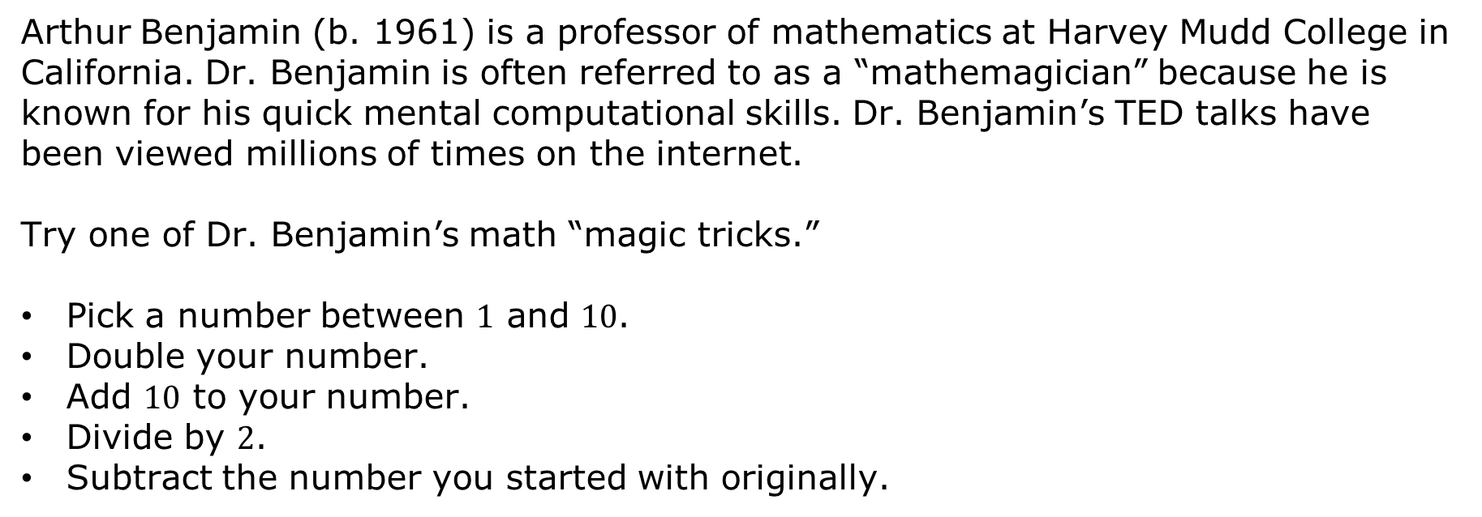
9.9.1 Warm-Up: Math Magic
Arthur Benjamin (b. 1961) is a professor of mathematics at Harvey Mudd College in California. Dr. Benjamin is often referred to as a “mathemagician” because he is known for his quick mental computational skills. Dr. Benjamin’s TED talks have been viewed millions of times on the internet.
Try one of Dr. Benjamin’s math “magic tricks.”
Pick a number between $1$ and $10$.
Double your number.
Add $10$ to your number.
Divide by $2$.
Subtract the number you started with originally.
volume 2, pg. 100

Slide 7
What number did you get?
Compare your number with your partner’s number. What do you notice?
Why do you think the “trick” works?
volume 2, pg. 100

Slide 8

Collaboration
volume 2, pg. 101

Slide 9

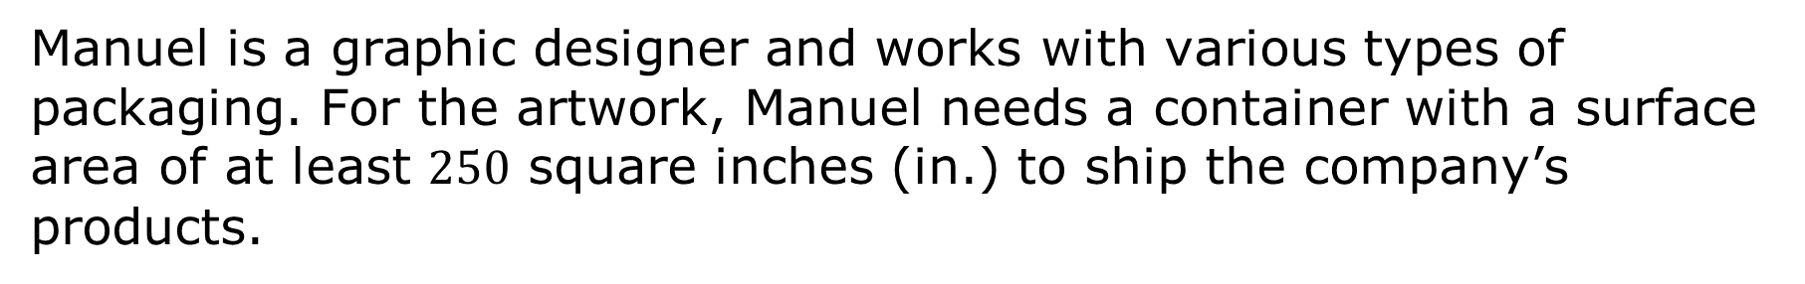
9.9.2 Collaboration: The Best Package
Manuel is a graphic designer and works with various types of packaging. For the artwork, Manuel needs a container with a surface area of at least $250$ square inches (in.) to ship the company’s products.
volume 2, pg. 101

Slide 10
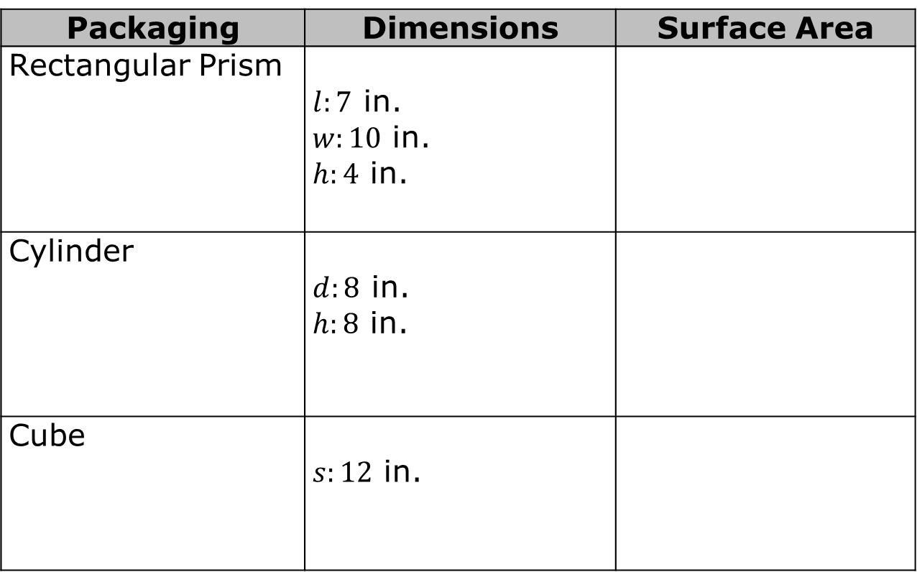
The three types of packaging that the company has in stock are shown in the table. Find the surface area for each type of packaging.
Packaging | Dimensions | Surface Area
Rectangular Prism | $l:7$ in. $w:10$ in. $h:4$ in.
Cylinder | $d:8$ in. $h:8$ in.
Cube | $s:12$ in.
volume 2, pg. 101

Slide 11
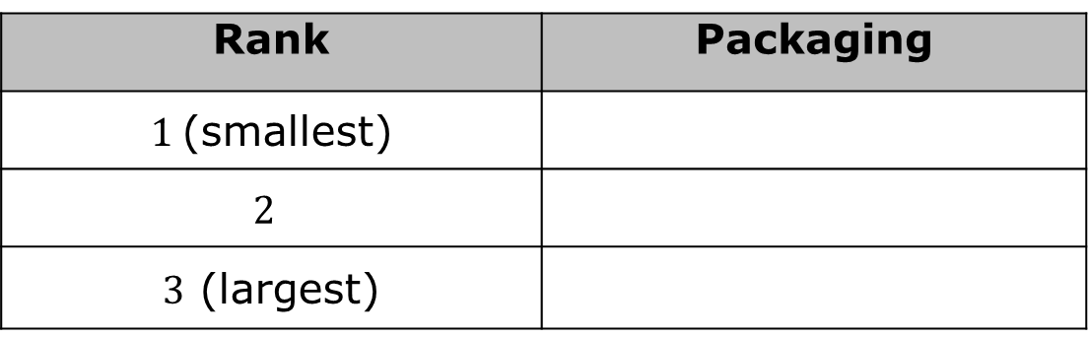
Rank the packaging’s surface area from smallest to largest.
Rank | Packaging
$1$(smallest)
$$2$$
$3$ (largest)
volume 2, pg. 101

Slide 12
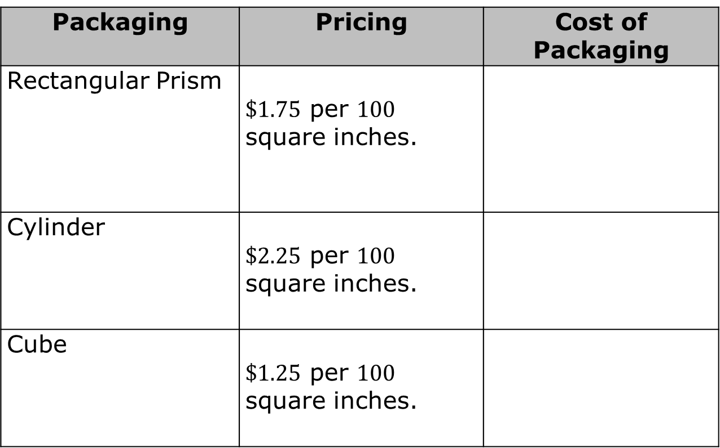
The prices for packaging are listed in the table. Based on the surface area of each package, find the cost of each type of packaging.
Packaging | Pricing | Cost of Packaging
Rectangular Prism | $\$1.75$ per $100$ square inches.
Cylinder | $\$2.25$ per $100$ square inches.
Cube | $\$1.25$ per $100$ square inches.
volume 2, pg. 101

Slide 13
If Manuel wants to use the cheapest packaging possible for his client, which packaging should he choose?
volume 2, pg. 101

Slide 14

Guided Instruction
volume 2, pg. 102

Slide 15
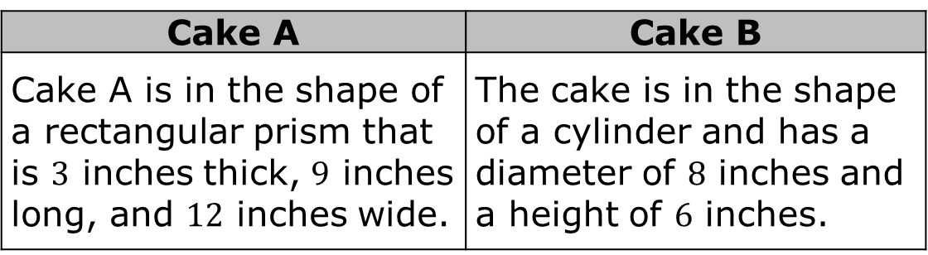
9.9.3 Guided Instruction: Real-Life Applications of Surface Area
Jeni owns a bakery and is making two cakes.
Cake A | Cake B
Cake A is in the shape of a rectangular prism that is $3$ inches thick, $9$ inches long, and $12$ inches wide. | The cake is in the shape of a cylinder and has a diameter of $8$ inches and a height of $6$ inches.
volume 2, pg. 102

Slide 16
When Jeni frosts the cake, she applies the frosting to all surfaces except for the bottom of the cake. Determine the amount of frosting Jeni needs to apply to each cake. Show your work.
Cake A | Cake B
volume 2, pg. 102

Slide 17
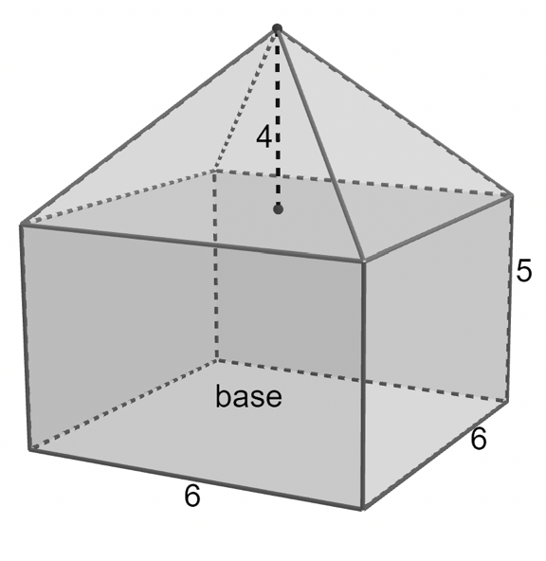
Jeni makes a two-layer cake, as shown, where the measurements are in inches (in.) She will frost all of the cake except for the base. The frosting between the pyramid and the prism helps to hold the two cakes together. Determine the total surface area that Jeni needs to frost.
volume 2, pg. 102

Slide 18
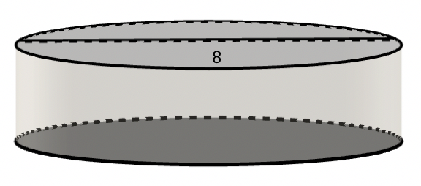
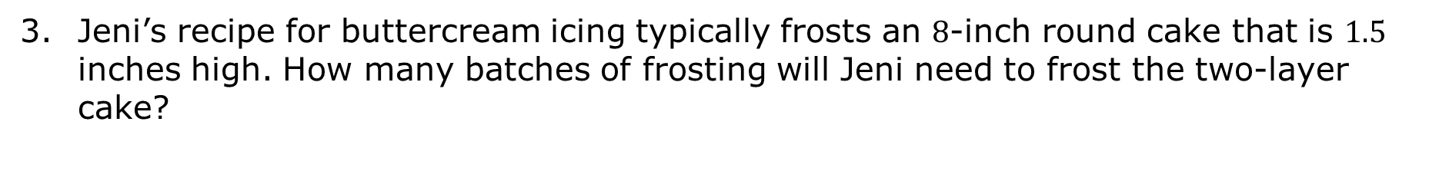
Jeni’s recipe for buttercream icing typically frosts an $8$‑inch round cake that is $1.5$ inches high. How many batches of frosting will Jeni need to frost the two-layer cake?
volume 2, pg. 102

Slide 19

Guided Practice
volume 2, pg. 103

Slide 20

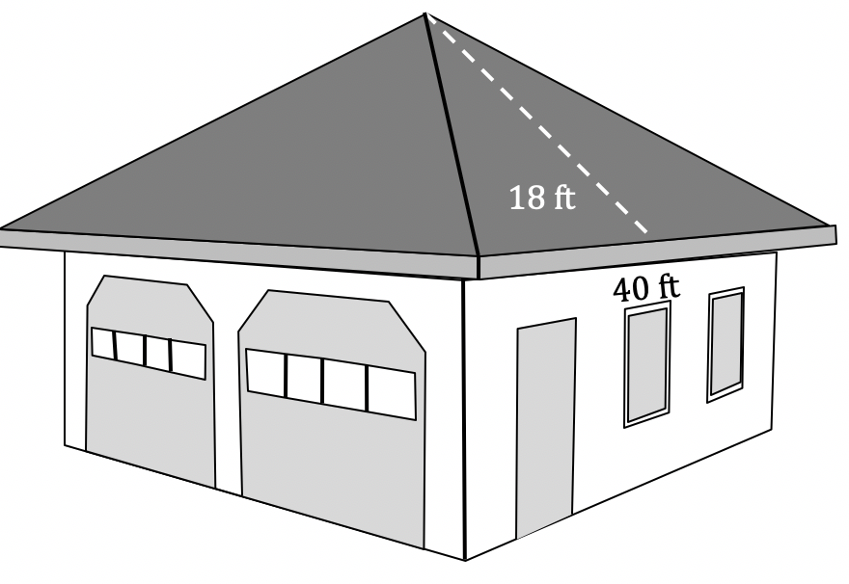
9.9.4 Guided Practice: Real-Life Applications of Surface Area
Lourdes’ garage is in the shape of a square pyramid. The garage is shown, with dimensions given in feet (ft).
volume 2, pg. 103

Slide 21
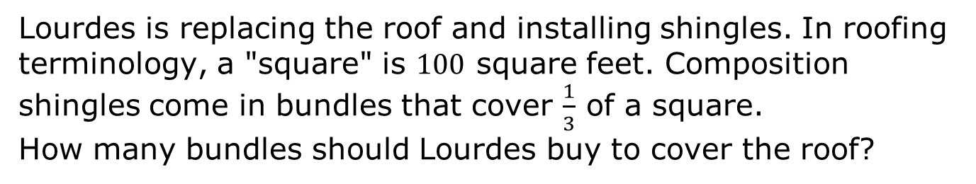
Lourdes is replacing the roof and installing shingles. In roofing terminology, a "square" is $100$ square feet. Composition shingles come in bundles that cover $\frac{1}{3}$ of a square.
How many bundles should Lourdes buy to cover the roof?
volume 2, pg. 103

Slide 22
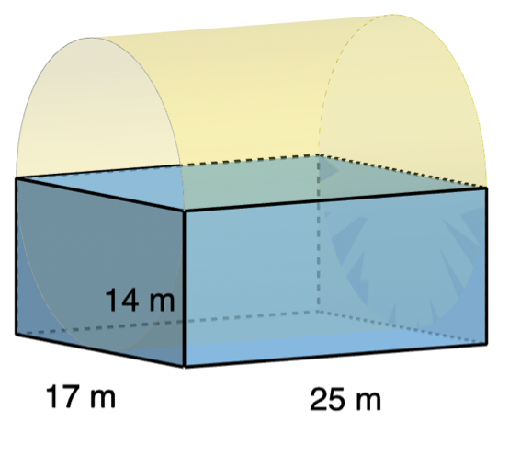
An architect is designing an art gallery. She used computer software to create a rough sketch of her idea. Her sketch is shown with measurements in meters (m). She would like for the art gallery to be all glass. To determine the estimated cost, she would need to find the area of all of the surfaces except for the floor. Determine the total surface area, in square meters, of the glass in the art gallery. Round to the nearest thousandth.
volume 2, pg. 103

Slide 23

Wrap-Up
volume 2, pg. 104

Slide 24
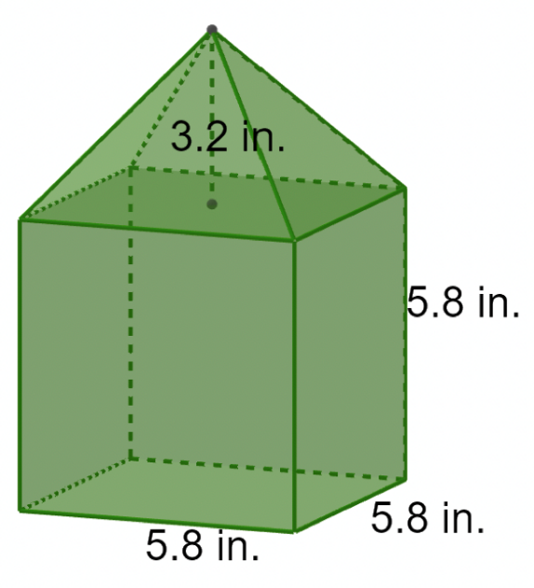
9.9.5 Wrap-Up: Ticket Out the Door
Jillian was building a birdhouse. Some of the dimensions, in inches (in.), of the birdhouse are shown. Determine the total amount of wood, in square inches, that Jillian will need to build the outside of the birdhouse.
volume 2, pg. 104

